Slide 1
Coursera Capstone Project : Applied Data Science
Kiran Panasa, India.
1210415441@gitam.in

Slide 2
Overview
Introduction
Business Problem
Data Required
Data Acquisition Approach
Data Usage Approach – Clustering
Methodology
Results
Conclusion

Slide 3
Introduction
The city of Hoboken, NJ is relatively small at ~1 square mile but it is packed with restaurants, night life and amazing people. For people that are new to Hoboken, despite its small geographic size, it can be daunting to figure out what restaurants are worth going to and where they are. For people that used to live in Hoboken or are visiting Hoboken, how do you know what the best places are to get something to eat?

Slide 4
Business Problem
For this project, I am going to put on my entrepreneur hat and create a simple guide on where to eat based on Foursquare likes, restaurant category and geographic location data for restaurants in Hoboken. I will then cluster these restaurants based on their similarities so that a user can easily determine what type of restaurants are best to eat at based on Foursquare user feedback.

Slide 5
Data Required
For this assignment , I will be utilizing the Foresquare API to pull the following location data on restaurants in Hoboken, NJ.
Venue Name
Venue ID
Venue Location
Venue Category
Rating
Price
Count of Likes
Phrases

Slide 6
Data Acquisition Approach
To acquire the data mentioned above, I will need to do the following:
Get geolocator latitude and longitude coordinates for Hoboen, NJ.
Get a list of all venues in Hoboken
Get venue ID’s for each venue in Hoboken.
Pull venue name, location, category, rating, price, count of likes and phrases for each venue.

Slide 7
Data Usage Approach - Clustering
I will take the gathered data (see above in Data Acquisition Approach and Data Required sections) and will create a K-means clustering algorithm that groups restaurants into 4-5 clusters so that people looking to eat in Hoboken can easily see which restaurants will cater to their needs.

Slide 8
Methodology
The thought process behind this is that likes are proxy for quality. The more likes there are, the better the restaurant is. This might be incorrect but API call issues (how many I can use for free) holds me back from getting price / rating data. I will then bin this data into a quality categorical variables so we can cluster appropriately.
I am also going to create new categorical variables for the restaurants to better group them based on type of cuisine. This way you can look for good Mexican food or now what type of food might be best to eat in Hoboken if you are new to the area.
I will take the gathered data (see above in Data Acquisition Approach and Data Required sections) and will create a k-means clustering algorithm that groups restaurants into 4-5 clusters so that people looking to eat in Hoboken can easily see which restaurants are the best to eat at, what cuisine is available and where in Hoboken they can look to eat.

Slide 9
Results
Running my clustering algorithm, I was able to generate four clusters of restaurants.

Slide 10
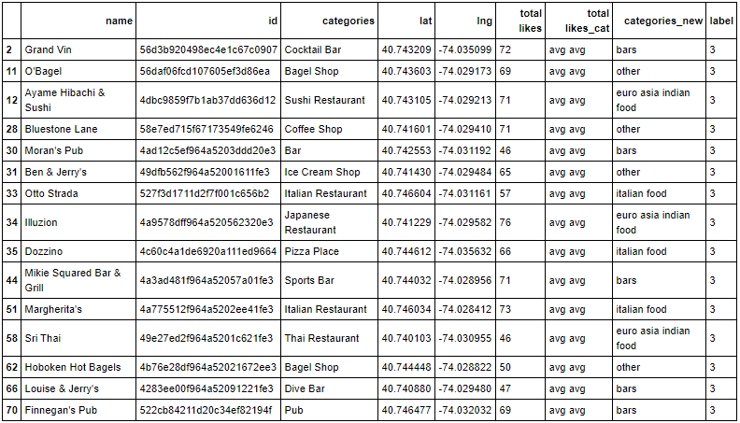
Cluster 1:
Characteristics
Poor quality food
Mostly Italian food or other

Slide 11
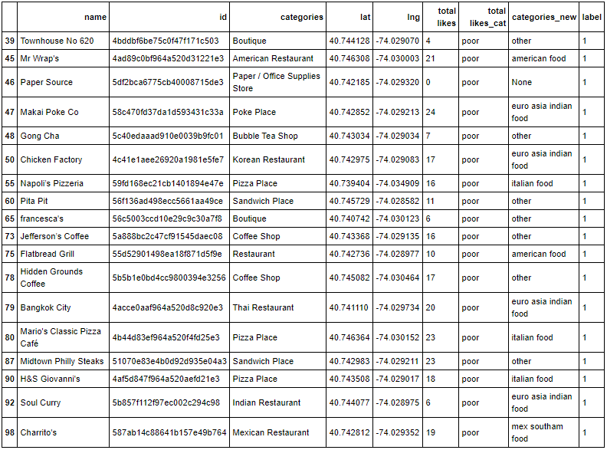
Cluster 2:
Below average quality food
Mostly Europe / Asia inspired food

Slide 12
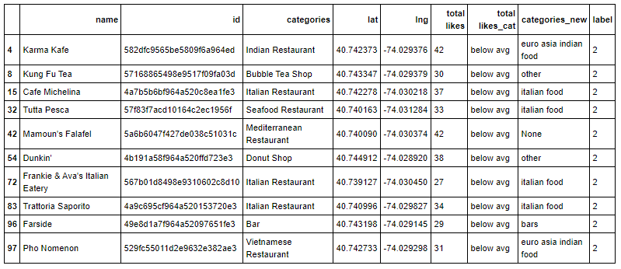
Cluster 3:
Characteristics
High quality food
Mostly Mexican and South American inspired food

Slide 13
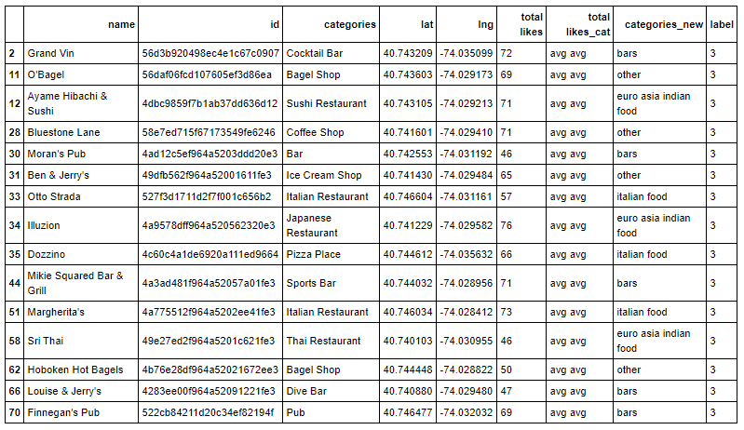
Cluster 4:
Characteristics
Above average quality food
Mostly Bars

Slide 14
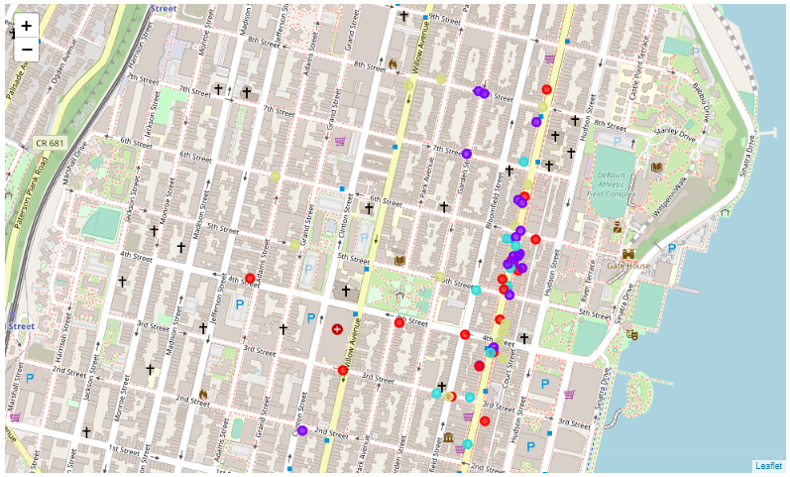
Conclusion
Map of Clusters for Users

